Slide 1
Lecture 1: Optimal Pricing for Monopoly with Multiple Goods
Jacob LaRiviere

Slide 2
Composite Commodity Theory
Assume there are n goods (e.g., apples, bananas, carrots, etc…) but we really only care about one of them (e.g., apples).
How do we handle this problem as economists?
Lets start with the very general consumer’s problem: constrained maximization.
Needed assumptions are completeness, reflexivity and transitivity.

Slide 3
Composite Commodity Theory
Suggestion: Say that we only solved this optimization problem for goods 2, …, n.
Take the first good as a parameter [e.g., like ‘m’ in y(x)=mx+b]
$$\max_{x_{1},x_{2},…,x_{n}}{U\left(x_{1},x_{2},…,x_{n}\right) s.t. p_{1}∙x_{1}+…+p_{n}∙x_{n}≤I}$$
Assume there are n goods (e.g., apples, bananas, carrots, etc…) but we really only care about one of them (e.g., apples).
How do we handle this problem as economists?
Lets start with the very general consumer’s problem: constrained maximization.
Needed assumptions are completeness, reflexivity and transitivity.

Slide 4
Composite Commodity Theory
Suggestion: Say that we only solved this optimization problem for goods 2, …, n.
Take the first good as a parameter [e.g., like ‘m’ in y(x)=mx+b]
This leads to a bunch of solution functions for all of the variables…
$$\max_{x_{1},x_{2},…,x_{n}}{U\left(x_{1},x_{2},…,x_{n}\right) s.t. p_{1}∙x_{1}+…+p_{n}∙x_{n}≤I}$$
Assume there are n goods (e.g., apples, bananas, carrots, etc…) but we really only care about one of them (e.g., apples).
How do we handle this problem as economists?
Lets start with the very general consumer’s problem: constrained maximization.
Needed assumptions are completeness, reflexivity and transitivity.
$$\max_{ x_{2},…,x_{n}}{U\left(x_{2},…,x_{n};x_{1}\right) s.t. p_{2}∙x_{2}+…+p_{n}∙x_{n}≤\hat{I}}$$

Slide 5


Composite Commodity Theory
Suggestion: Say that we only solved this optimization problem for goods 2, …, n.
Take the first good as a parameter [e.g., like ‘m’ in y(x)=mx+b]
This leads to a bunch of solution functions for all of the variables…
NOTE: I now is $\hat{I}$; we’re netting out expenditures on goods 2, 3, …, n.
$$\max_{x_{1},x_{2},…,x_{n}}{U\left(x_{1},x_{2},…,x_{n}\right) s.t. p_{1}∙x_{1}+…+p_{n}∙x_{n}≤I}$$
Assume there are n goods (e.g., apples, bananas, carrots, etc…) but we really only care about one of them (e.g., apples).
How do we handle this problem as economists?
Lets start with the very general consumer’s problem: constrained maximization.
Needed assumptions are completeness, reflexivity and transitivity.
$$\max_{ x_{2},…,x_{n}}{U\left(x_{2},…,x_{n};x_{1}\right) s.t. p_{2}∙x_{2}+…+p_{n}∙x_{n}≤\hat{I}}$$
$$x_{2}^{∗}\left(p_{2},…,p_{n},\hat{I}\right), …,x_{n}^{∗}\left(p_{2},…,p_{n},\hat{I}\right)$$

Slide 6
Composite Commodity Theory
Idea: with these “solution functions” for the goods we don’t care about, lets plug them back in to the original utility function…
This reduces the problem to a function of a bunch of parameters (e.g., m and b) rather than variables (e.g., y and x).
This is useful; parameters aren’t complicated but variables are!

Slide 7
Composite Commodity Theory
$x_{2}^{∗}\left(p_{2},…,p_{n},\hat{I}\right), …,x_{n}^{∗}\left(p_{2},…,p_{n},\hat{I}\right)$ -> $U\left(x_{1},x_{2},…,x_{n} \right)$
Idea: with these “solution functions” for the goods we don’t care about, lets plug them back in to the original utility function…
This reduces the problem to a function of a bunch of parameters (e.g., m and b) rather than variables (e.g., y and x).
This is useful; parameters aren’t complicated but variables are!

Slide 8

Composite Commodity Theory
Call this new function “V” and let x₁ vary again:
$x_{2}^{∗}\left(p_{2},…,p_{n},\hat{I}\right), …,x_{n}^{∗}\left(p_{2},…,p_{n},\hat{I}\right)$ -> $U\left(x_{1},x_{2},…,x_{n} \right)$
Idea: with these “solution functions” for the goods we don’t care about, lets plug them back in to the original utility function…
This reduces the problem to a function of a bunch of parameters (e.g., m and b) rather than variables (e.g., y and x).
This is useful; parameters aren’t complicated but variables are!
$$U\left(x_{1},x_{2},…,x_{n}\right)=U\left(x_{1},x_{2}^{∗}\left(p_{2},…,p_{n},\hat{I}\right),…,x_{n}^{∗}\left(p_{2},…,p_{n},\hat{I}\right)\right)$$
$$=V\left(x_{1},\hat{I};p_{2},…,p_{n}\right)$$

Slide 9

Composite Commodity Theory
Call this new function “V” and let x₁ vary again:
Noting that the prices of goods 2, 3, …, n are fixed, consider maximizing V
$x_{2}^{∗}\left(p_{2},…,p_{n},\hat{I}\right), …,x_{n}^{∗}\left(p_{2},…,p_{n},\hat{I}\right)$ -> $U\left(x_{1},x_{2},…,x_{n} \right)$
Idea: with these “solution functions” for the goods we don’t care about, lets plug them back in to the original utility function…
This reduces the problem to a function of a bunch of parameters (e.g., m and b) rather than variables (e.g., y and x).
This is useful; parameters aren’t complicated but variables are!
$$U\left(x_{1},x_{2},…,x_{n}\right)=U\left(x_{1},x_{2}^{∗}\left(p_{2},…,p_{n},\hat{I}\right),…,x_{n}^{∗}\left(p_{2},…,p_{n},\hat{I}\right)\right)$$
$$=V\left(x_{1},\hat{I};p_{2},…,p_{n}\right)$$
$\max_{x_{1},\hat{I}} V\left(x_{1},\hat{I};p_{2},…,p_{n}\right)$ s.t. $p_{1}∙x_{1}+\hat{I}≤I$

Slide 10
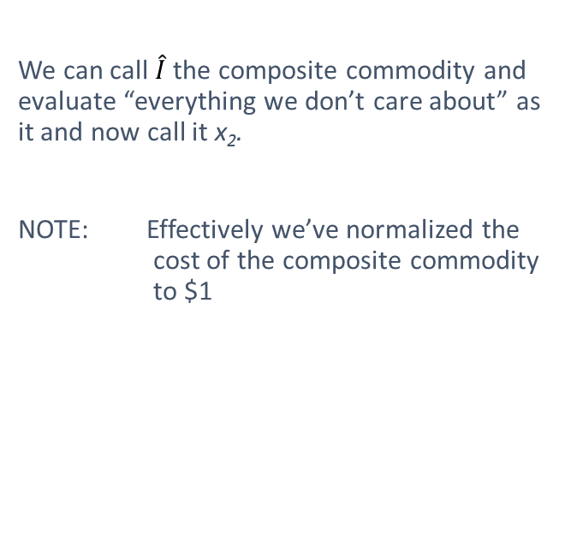
Composite Commodity Theory
We can call $\hat{I}$ the composite commodity and evaluate “everything we don’t care about” as it and now call it x₂.
NOTE: Effectively we’ve normalized the cost of the composite commodity to $1

Slide 11



Composite Commodity Theory
This problem has a solution where for different levels of p₁ and I there are different solutions for $x_{1}$ and $x_{2}$.
$\max_{x_{1},x_{2}} V\left(x_{1},x_{2}\right)$ s.t. $p_{1}∙x_{1}+x_{2}≤I$
We can call $\hat{I}$ the composite commodity and evaluate “everything we don’t care about” as it and now call it x₂.
NOTE: Effectively we’ve normalized the cost of the composite commodity to $1
$x_{1}^{∗}\left(p_{1},I \right)$, $x_{2}^{∗}\left(p_{1},I \right)$

Slide 12

Composite Commodity Theory
This problem has a solution where for different levels of p₁ and I there are different solutions for $x_{1}$ and $x_{2}$.
Finally, plot $x_{1}^{∗}\left(p_{1},I \right)$ against $p_{1}$ and voila! You have a demand curve…
…sum them over all consumers and you have a market demand curve!
$\max_{x_{1},x_{2}} V\left(x_{1},x_{2}\right)$ s.t. $p_{1}∙x_{1}+x_{2}≤I$
We can call $\hat{I}$ the composite commodity and evaluate “everything we don’t care about” as it and now call it x₂.
NOTE: Effectively we’ve normalized the cost of the composite commodity to $1
$x_{1}^{∗}\left(p_{1},I \right)$, $x_{2}^{∗}\left(p_{1},I \right)$

Slide 13
Why Markets are Sometimes Not Awesome

Slide 14
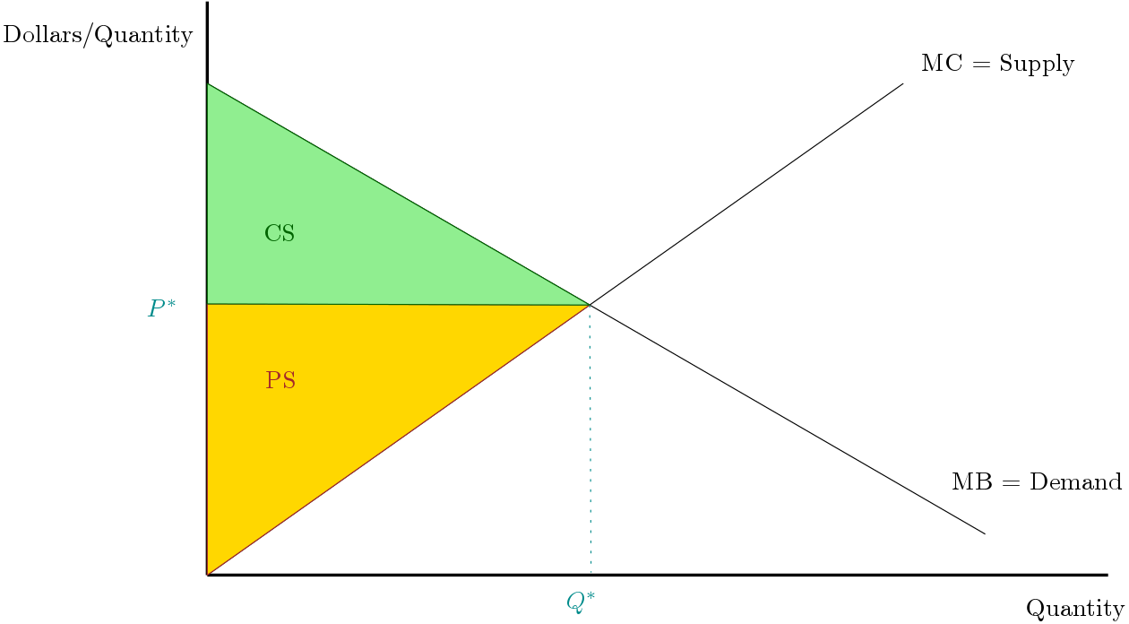
Markets maximize welfare if 1) there is no market power and 2) all benefits/costs borne by market participants.

Slide 15



GDP = Consumption + Investment + Government Spending + Net Exports = C + I + G + X
Why the need for G at all?
- One issue is regulating and standard setting for markets

Slide 16
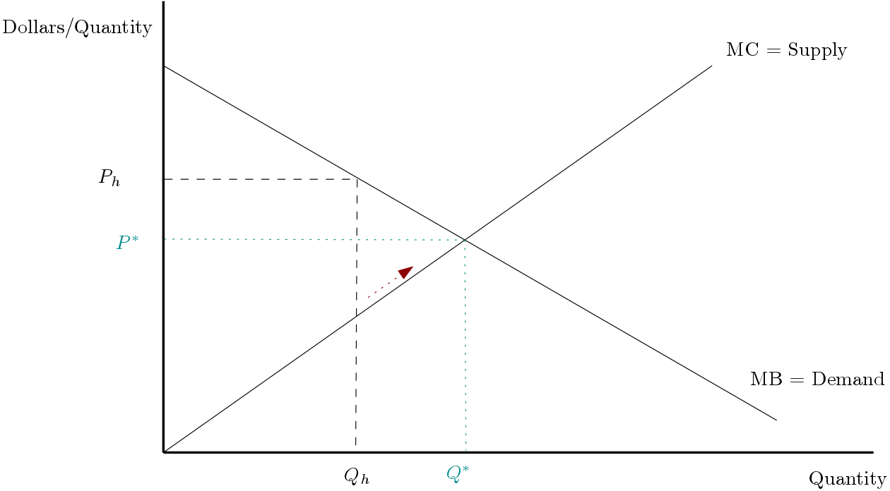
Monopolies and lack of competition
Lack of competition can create bad outcomes: high prices and low quality (ISPs)
Why?
A key feature of markets was the discipline other participants put on reaching the efficient P* and Q*
Without other firms able to enter, things get bad…

Slide 17
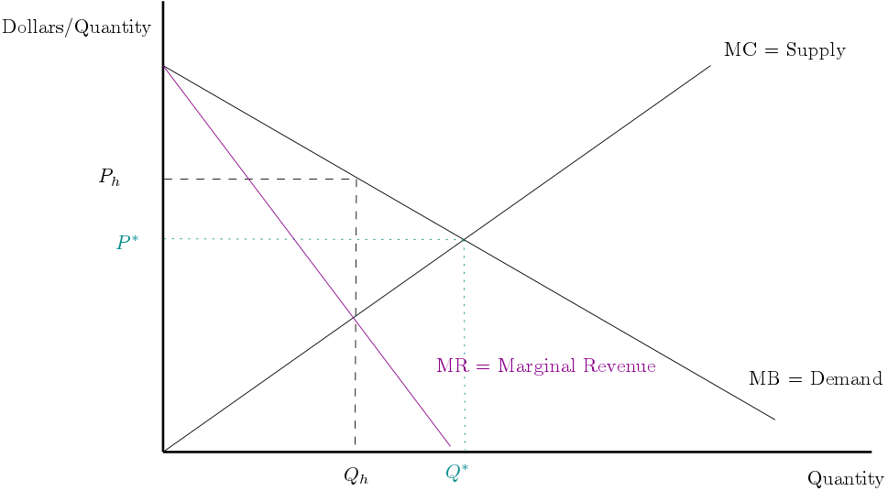
Monopolies and lack of competition
A single firm serving the market evaluates their marginal revenue from setting different market prices.

Slide 18
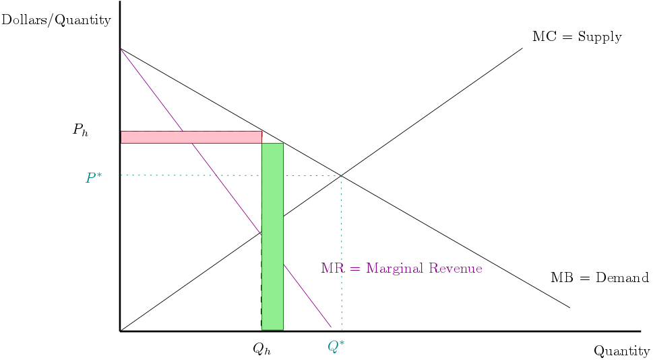
Monopolies and lack of competition
If a single firm served the market and was thinking to decrease their price below P_{h} they lose on the intensive margin but they gain on the extensive margin.

Slide 19
Monopolies and lack of competition
If a single firm served the market and was thinking to decrease their price below P_{h} they lose on the intensive margin but they gain on the extensive margin.
They then can compare the additional revenue from selling more against the cost of producing it.

Slide 20
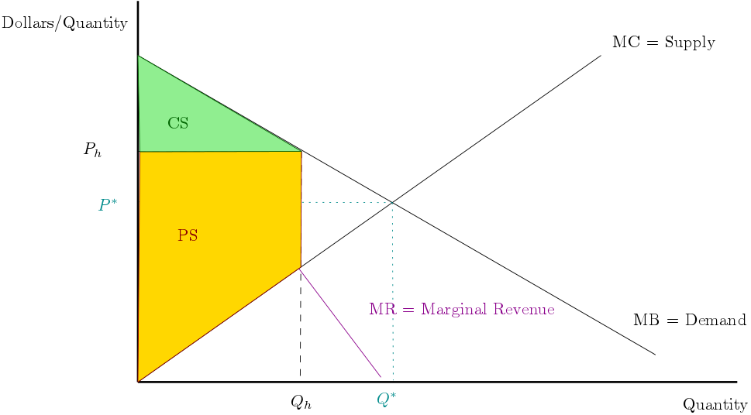
Monopolies and lack of competition
At this price of P_{h} the PS (e.g., profits) is pretty big and some consumers benefit.

Slide 21
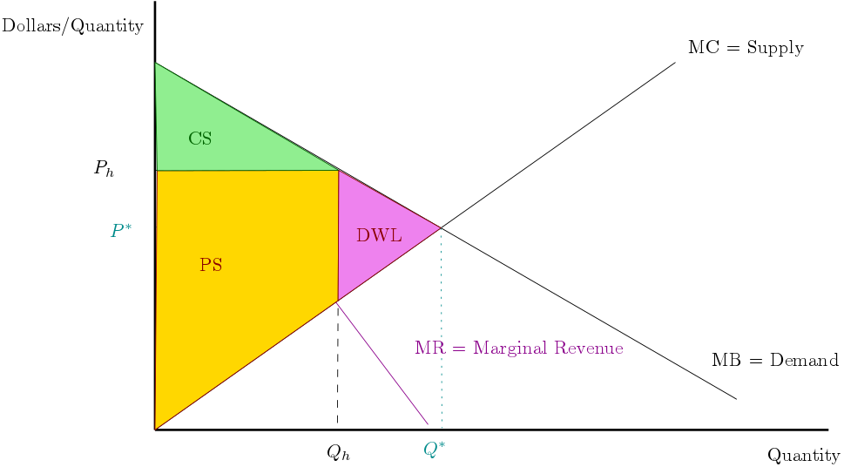
Monopolies and lack of competition
At this price of P_{h} the PS (e.g., profits) is pretty big and some consumers benefit.
However society would be made much better off at Q* relative to Q_{h} because the MB from society is bigger than the cost to produce it creating DWL in the monopoly equilibrium.

Slide 22
Monopolies and lack of competition
Total welfare is lower but incidence favors the monopolist

Slide 23
Monopolies and lack of competition
Monopolies are the extreme case, but lower levels of competition lead to similar outcomes.
“Concentration” in an industry implies only a few firms serving the market.

Slide 24



Monopolies are sometimes a good thing…
If there are very large fixed costs in an industry it can mean there is a natural monopoly or that the monopoly profits are needed to cover those fixed costs.
e.g., electric utilities, ISPs (???), etc.
There are better and worse ways to handle these situations.
- rate of return regulation is generally a bad one as it encourages overinvestment.

Slide 25
Monopolies can be needed
MC doesn’t include fixed costs.
If fixed costs are large the PS might be needed to have the service be provided.
If the alternative is Q = 0, the monopoly outcome starts to look pretty good!

Slide 26
Standard Setting…
DOJ regulates mergers to ensure they don’t reduce competition too much.
FCC and other federal agencies set standards to facilitate competition.
What type of WiFi frequencies will be used (traditional standard setting)?
What structure internet content has & net neutrality (market mechanism design)?

Slide 27

Standard Setting versus Regulation…
What is the reason we need building permits?
Basic assumption is that
Homeowners don’t have full information or
Aren’t going to make smart investments.
This isn’t fully to decrease uncertainty through coordination of market participants as in standard setting.

Slide 28
Markets maximize welfare if 1) there is no market power and 2) all benefits/costs borne by market participants.

Slide 29

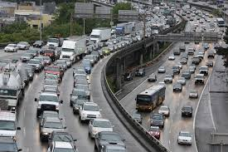


Government useful to encourage healthy markets
Even with lots of competition there can be market failure if there are costs or benefits external to market participants.
This is a very old and continuing problem

Slide 30
How do monopolists price goods?

Slide 31
Monopolists, like all firms, should price to maximize profits.
As a result, the demand curve and costs matter

Slide 32
Monopolists, like all firms, should price to maximize profits.
As a result, the demand curve and costs matter
Perfect Comp: MB = MC = P
(other firms can undercut price otherwise)

Slide 33
Monopolists, like all firms, should price to maximize profits.
As a result, the demand curve and costs matter
Monopolist doesn’t have to worry about competitors -> set Q such that MC = MR

Slide 34
Monopolists, like all firms, should price to maximize profits.
As a result, the demand curve and costs matter
Monopolist doesn’t have to worry about competitors -> set Q such that MC = MR
How to construct MR?
To sell another unit, must lower the price so firm loses money on units they were selling (intensive margin) and gains money from additional units sold (extensive margin)
MR = extensive gains – intensive losses

Slide 35






Monopolist’s math
$$\max_{q} π\left(q\right)=P\left(q\right)q −TC(q)$$
f.o.c.: $P^{′}\left(q^{∗}\right)q^{∗}+P\left(q^{∗}\right)−TC^{′}\left(q^{∗}\right)=0$
Maximizes profits (TR – TC) by setting a quantity and charging needed price to have market clear
e.g., price is a function of quantity: P(q) and note the TR = P(q)*q
$P^{′}\left(q^{∗}\right)q^{∗}+P\left(q^{∗}\right)−MC\left(q^{∗}\right)=0$
$P^{′}\left(q^{∗}\right)q^{∗}+P\left(q^{∗}\right)=MC\left(q^{∗}\right)$
NOTE: P’(q) < 0 since demand slopes downward
$$P^{′}\left(q^{∗}\right)q^{∗}$$
Intensive margin loss as q increases
$$P\left(q^{∗}\right)$$
Extensive margin gain as q increases

Slide 36

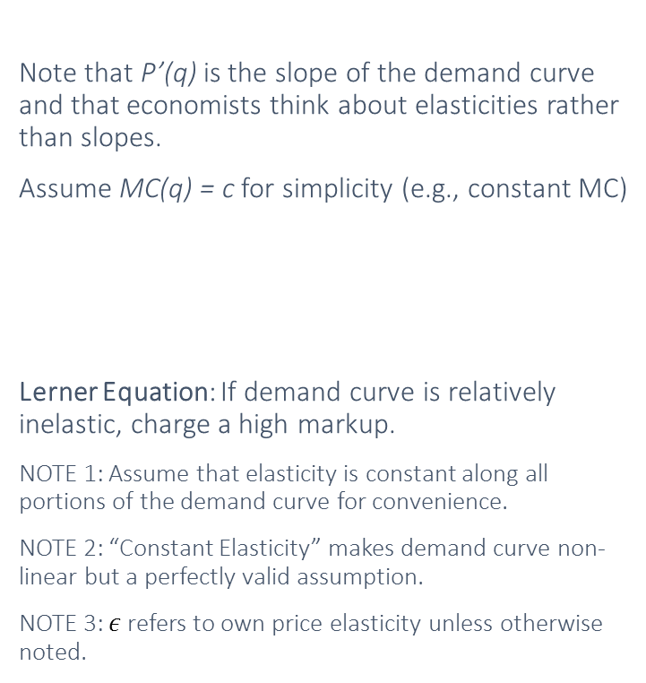
Monopolist’s math
$P^{′}\left(q^{∗}\right)q^{∗}+P\left(q^{∗}\right)=MC\left(q^{∗}\right)$
Note that P’(q) is the slope of the demand curve and that economists think about elasticities rather than slopes.
Assume MC(q) = c for simplicity (e.g., constant MC)
Lerner Equation: If demand curve is relatively inelastic, charge a high markup.
NOTE 1: Assume that elasticity is constant along all portions of the demand curve for convenience.
NOTE 2: “Constant Elasticity” makes demand curve non-linear but a perfectly valid assumption.
NOTE 3: $ε$ refers to own price elasticity unless otherwise noted.

Slide 37
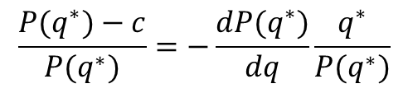
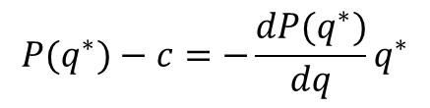

Monopolist’s math
$P^{′}\left(q^{∗}\right)q^{∗}+P\left(q^{∗}\right)=MC\left(q^{∗}\right)$
$\frac{dP(q^{∗})}{dq}q^{∗}+P(q^{∗})=c$
Note that P’(q) is the slope of the demand curve and that economists think about elasticities rather than slopes.
Assume MC(q) = c for simplicity (e.g., constant MC)
Lerner Equation: If demand curve is relatively inelastic, charge a high markup.
NOTE 1: Assume that elasticity is constant along all portions of the demand curve for convenience.
NOTE 2: “Constant Elasticity” makes demand curve non-linear but a perfectly valid assumption.
NOTE 3: $ε$ refers to own price elasticity unless otherwise noted.
$$P(q^{∗})−c=−\frac{dP(q^{∗})}{dq}q^{∗}$$
Divide both sides by P
$$\frac{P(q^{∗})−c}{P(q^{∗})}=−\frac{dP(q^{∗})}{dq}\frac{q^{∗}}{P(q^{∗})}$$

Slide 38
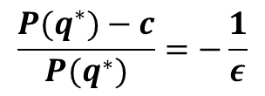
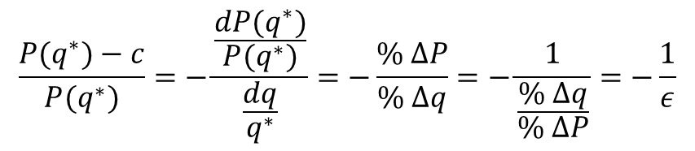
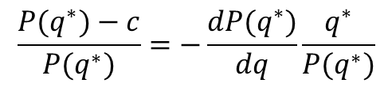
Monopolist’s math
$P^{′}\left(q^{∗}\right)q^{∗}+P\left(q^{∗}\right)=MC\left(q^{∗}\right)$
$\frac{dP(q^{∗})}{dq}q^{∗}+P(q^{∗})=c$
Note that P’(q) is the slope of the demand curve and that economists think about elasticities rather than slopes.
Assume MC(q) = c for simplicity (e.g., constant MC)
Lerner Equation: If demand curve is relatively inelastic, charge a high markup.
NOTE 1: Assume that elasticity is constant along all portions of the demand curve for convenience.
NOTE 2: “Constant Elasticity” makes demand curve non-linear but a perfectly valid assumption.
NOTE 3: $ε$ refers to own price elasticity unless otherwise noted.
$$P(q^{∗})−c=−\frac{dP(q^{∗})}{dq}q^{∗}$$
Divide both sides by P
$$\frac{P(q^{∗})−c}{P(q^{∗})}=−\frac{dP(q^{∗})}{dq}\frac{q^{∗}}{P(q^{∗})}$$
$$\frac{P(q^{∗})−c}{P(q^{∗})}=−\frac{\frac{dP(q^{∗})}{P(q^{∗})}}{\frac{dq}{q^{∗}}}=−\frac{\% ΔP}{\% Δq}=−\frac{1}{\frac{\% Δq}{\% ΔP}}=−\frac{1}{ε}$$
$$\frac{P(q^{∗})−c}{P(q^{∗})}=−\frac{1}{ε}$$

Slide 39
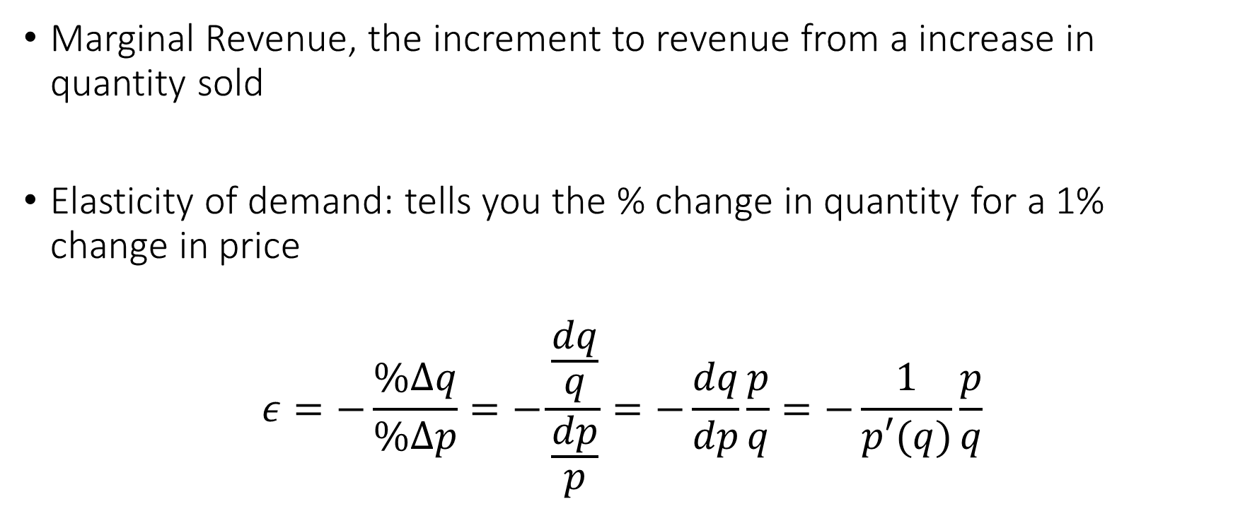
Choosing Quantity
Marginal Revenue, the increment to revenue from a increase in quantity sold
Elasticity of demand: tells you the % change in quantity for a 1% change in price
$$ε=−\frac{\%Δq}{\%Δp}=−\frac{\frac{dq}{q}}{\frac{dp}{p}}=−\frac{dq}{dp}\frac{p}{q}=−\frac{1}{p′(q)}\frac{p}{q}$$

Slide 40

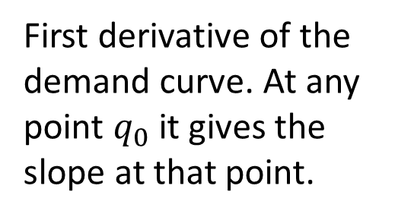
Examining the elasticity function
The demand curve. Gives the price as function of q.
$$ε=−\frac{1}{p^{′}\left(q\right)}\frac{p(q)}{q}$$
First derivative of the demand curve. At any point $q_{0}$ it gives the slope at that point.
Relative levels of price and quantity

Slide 41

Special case: linear demand
At high prices, q is low. A 1% change in p is relatively large, especially compared to quantity. Elasticities will be relatively large.
$$ε=−\frac{1}{slope}\frac{p(q)}{q}$$
First derivative is constant
At low prices, p will be small and q is large. Elasticities will mechanically be low.
NOTE: This is about within a demand curve. We generally talk about demand for a product generally.

Slide 42
Some general facts about elasticity
At high prices, a fixed % change in price is larger in level terms. Since q will tend to small, a given level change in q, will be a larger in percentage terms.
This creates a relationship such that elasticities will tend to be high at the “top of the demand curve” and low at the bottom.
When we think of “small changes” in price, the impact of raising and lowering will be symmetric. However, for larger changes, e.g. 10%, an increase and decrease need to have the same magnitude impact

Slide 43
Elasticity and total revenue
Total revenue (TR) = p(q)*q
Product Rule
Algebra
Substituting in
Translating to calculus
Negative of this is elasticity

Slide 44
Elasticity and total revenue
Total revenue (TR) = p(q)*q
One minus the elasticity translates a price increase in percent to a revenue increase.
For example, if the elasticity is 3.5, a 10% price increase causes a -25% impact on revenue (a loss).
NOTE: Quantity impact is not a revenue impact!

Slide 45
Elasticity and total revenue
Elasticity = 1 → small changes in price do not impact revenue
Elasticity < 1 → price drops lower revenue, price increases raise revenue
Elasticity>1 → price drops raise revenue

Slide 46

Inverse Elasticity Rule
Profit Max (MR=MC)
  $$p−c^{′}\left(q\right)=−qp^{′}\left(q\right)$$
  $$\frac{p−c′(q)}{p}=−\frac{q}{p}p^{′}\left(q\right)=\frac{1}{ε}$$
MR
MC
Notes:
Necessarily elasticity > 1
Markup formula widely abused as a pricing strategy
Price-cost margin AKA Lerner index

Slide 47
Inverse Elasticity Rule
MR
MC
Profit Max (MR=MC)
Price-cost margin (Lerner index) = 1 over elasticity
Price minus marginal costs divided by price is referred to as gross margin.
Notes:
Necessarily elasticity > 1
Markup formula widely abused as a pricing strategy
Price-cost margin AKA Lerner index

Slide 48
Inverse Elasticity Rule
Suppose MC=0. Then quantity is chosen so that elasticity is 1.
Intuition: if marginal costs are zero, then optimize for revenue. Total revenue grows until elasticity = 1.
If MC>0, one will “stop” before reaching elasticity = 1.
Notes:
Necessarily elasticity > 1
Markup formula widely abused as a pricing strategy
Price-cost margin AKA Lerner index

Slide 49
Monopolies and lack of competition
At this price of P_{h} the PS (e.g., profits) is pretty big and some consumers benefit.
However society would be made much better off at Q* relative to Q_{h} because the MB from society is bigger than the cost to produce it creating DWL in the monopoly equilibrium.

Slide 50
Digression on Margin Formula
Perfect competition says price=MC, or zero markup, which implies elasticity of infinity. In other words, by deviating from market price I can sell all my units. What are some examples where this is approximately true in practice?

Slide 51
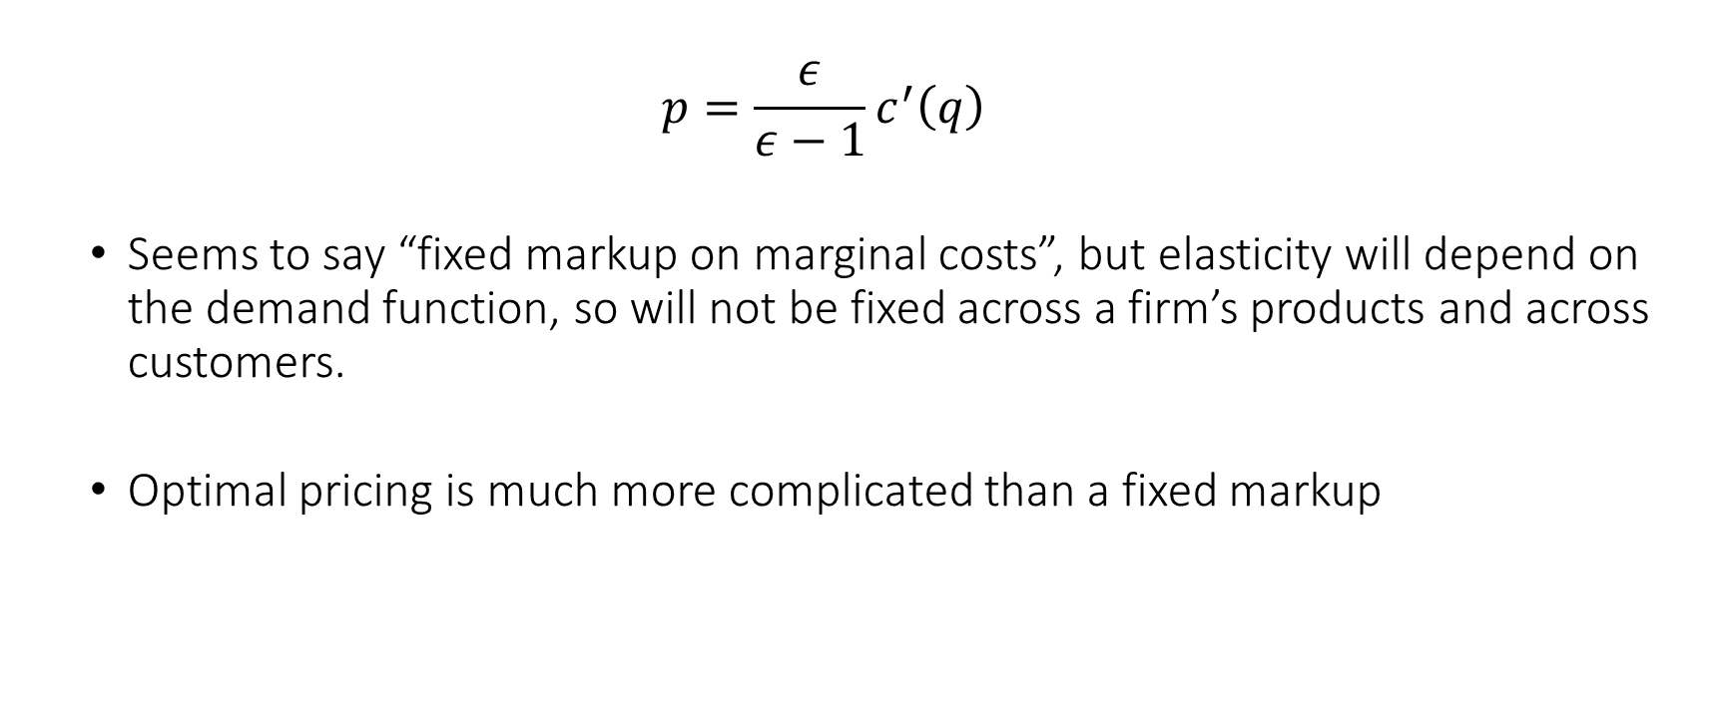
Markup formula cont.
  $$p=\frac{ε}{ε−1}c^{′}\left(q\right)$$
  Seems to say “fixed markup on marginal costs”, but elasticity will depend on the demand function, so will not be fixed across a firm’s products and across customers.
  Optimal pricing is much more complicated than a fixed markup
Note: Optimal prices are always on that elastic portion of the demand curve

Slide 52
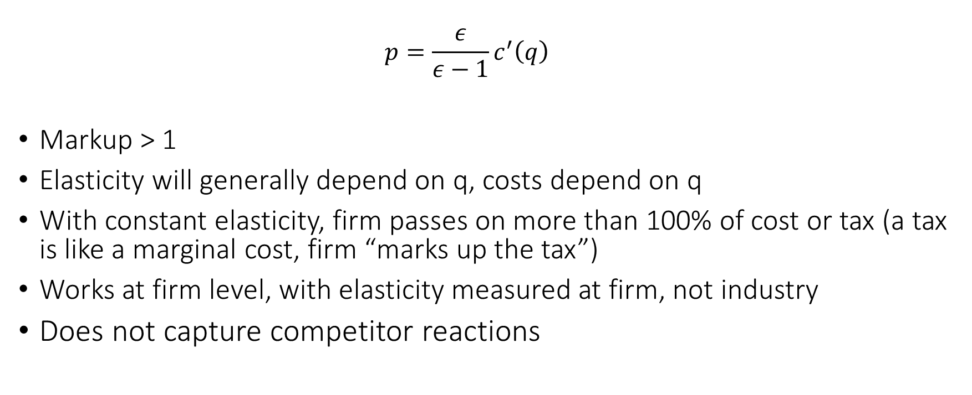
Markup formula cont.
  $$p=\frac{ε}{ε−1}c^{′}\left(q\right)$$
Markup > 1
Elasticity will generally depend on q, costs depend on q
With constant elasticity, firm passes on more than 100% of cost or tax (a tax is like a marginal cost, firm “marks up the tax”)
Works at firm level, with elasticity measured at firm, not industry
  Does not capture competitor reactions
Note: Optimal prices are always on that elastic portion of the demand curve

Slide 53
Monopoly Pricing Formula
Prices depends on elasticity, which depends on the product, customer characteristics
Offer discounts to elastic (price sensitive) customers
Discounts offered on basis of factors correlated with price sensitivity
Pricing can often be understood by how decision variables correlate with price sensitivity
Notes:
Can be converted into a markup formula
Often used to justify a “constant markup” policy
but it doesn’t justify that, since elasticity changes from market to market
In markets with less elastic demand, price higher. This is known as price discrimination

Slide 54
Pricing Multiple Goods

Slide 55
Basic idea
One firm selling multiple goods
A firm’s goods will, in general, “compete with each other” to some degree
A rational firm takes this into account when setting price. Optimal price will depend on own price elasticity (what we just learned about) and cross price elasticities

Slide 56
Review: substitutes and complements
Pricing Related Goods
Complements and Substitute Products (Relationship)
Sales of a good rise when the price of a complement falls
    Console and games
    Drinks and food at a restaurant (e.g. happy hour to attract customers)
Sales of a good fall when the price of a substitute falls
    Games vs. other games
    Food at a restaurant
Lower price of substitute cannibalizes demand from other product
Lower price of complement promotes sales of other product
Prices of substitutes (complements) are higher (lower) than standalone profit-maximizing prices
Sales of Good
Price of Complement
Sales of Good
Price of Substitute

Slide 57
Inverse Elasticity Rule 2
Suppose we sell n goods indexed i=1,…,n
Demands x_{i}(p)
Profit
If we assume constant marginal cost, this simplification is an example of selling the same good in multiple markets or to multiple customer “types”
Cross-price elasticity
Note no minus sign.
Positive → substitutes; Negative → complements

Slide 58





Bundling

Slide 59
Bundling
Pure bundling: only sell the bundle
  Cars & tires
  Cable TV
  Cars + feature “models”
Mixed bundling: sell separately with a discount for bundle
  Video games w/ console
  Sports passes (clubs, ski resorts)

Slide 60
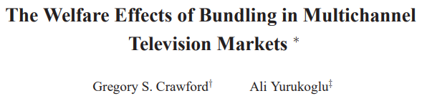
Conceptualizing bundles
A bundle can be thought of as a “conditional discount”. E.g. If you buy good 1, I’ll give you a discount on good 2.
  This lets firm give “targeted offers”
Powerful when valuation of good 2 is much lower if I already have good 1.
  Gym memberships bundle many partner locations for a small increase in price because otherwise people would rarely buy more than 1.
Makes pricing easier since valuation of bundle more similar than “one off” demand.
  Also interesting bargaining power aspects.

Slide 61
Utilities with Independent Values
Action | Utility
Buy Nothing | 0
Buy Good 1 | v₁ – p₁
Buy Good 2 | v₂ – p₂
Buy Both | v₁+v₂ – p_{B}

Slide 62
v₂
p_{B}
Buy neither, but would buy a bundle. Starting from the top right of the square, there is always some bundle I want to offer
Buy Good 2
Buy Both
p₂
Buy Good 1
Buy Nothing
v₁
p₁

Slide 63
v₂
p_{B}
Buy neither, but would buy a bundle. Starting from the top right of the square, there is always some bundle I want to offer
Buy Good 2
Buy Both
p₂
Buy Nothing
Buy Good 1
v₁
p₁

Slide 64
v₂
If p2 optimal, this price reduction doesn’t affect profits – sales gains just balance price cut
p_{B}
Buy Good 2
Buy Both
p₂
Buy Nothing
Buy Good 1
v₁
p₁

Slide 65
v₂
p_{B}
Buy Good 2
If p1 optimal, this price reduction doesn’t affect profits – sales gains just balance price cut
Buy Both
p₂
Buy Nothing
Buy Good 1
v₁
p₁

Slide 66
v₂
p_{B}
Buy Good 2
Reducing bundle price gives the additional sales of both goods with a single price cut
Buy Both
p₂
Buy Nothing
Buy Good 1
v₁
p₁

Slide 67
Bundling as a part of corporate strategy
Rethink Product
Jack Walsh noticed GE made more profit on engine service than aircraft engines
Redefined product: sell engines in order to sell service
  Rather than selling service to make engines more attractive
Very profitable
IBM pivoted from providing software and services to sell hardware
  IBM Global Services
Hardware margins typically low except Apple

Slide 68
Bundling Insights
Mixed bundling is always more profitable than no bundling
  With independent or negatively correlated goods
  Better for consumers as well!
Often a “grand bundle” does well for firms, but can be bad for consumers
  Skims out the most willing-to-pay with a “super good”
Bundles can be used to help customers

Slide 69
Appendix

Slide 70
Representative Consumer Assumption
If there is a representative consumer maximizing utility:
max u(x)-px, so
Thus there are symmetric cross-derivatives
From the total derivative of FOC
This rule need not hold in practice, but is a commonly made assumption
Recall this rule from multivariate calculus

Slide 71
In Matrix Notation
Price cost margin:
0 = 1 + E L, and thus L = - E⁻¹ 1
Notes:
Vector of ones, vector of inverse elasticities

Slide 72
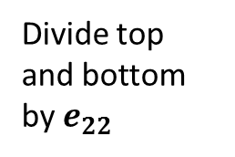
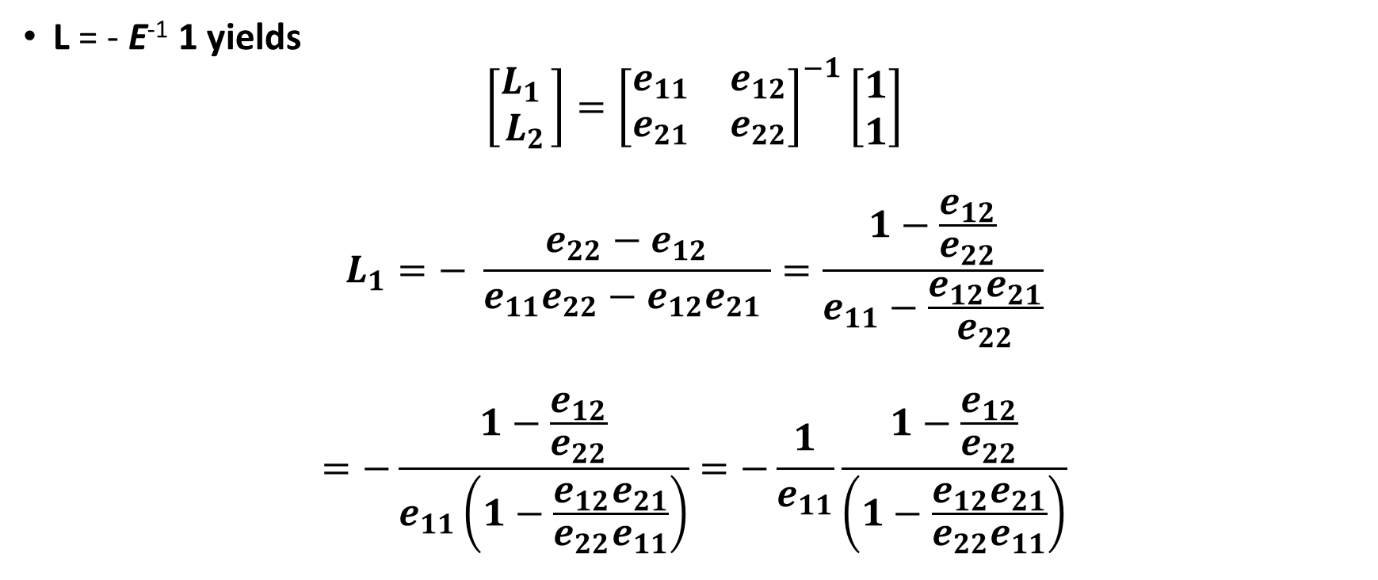

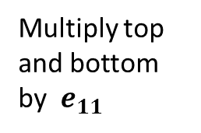
Two Good Formula
Rule for inverting a 2x2 matrix
L = - E⁻¹ 1 yields
$$\left[\begin{aligned}L_{1} \\ L_{2}\end{aligned}\right]={\left[\begin{matrix}e_{11} & e_{12} \\ e_{21} & e_{22}\end{matrix}\right]}^{−1}\left[\begin{aligned}1 \\ 1\end{aligned}\right]$$
$$L_{1}=− \frac{e_{22}−e_{12}}{e_{11}e_{22}−e_{12}e_{21} }=\frac{1−\frac{e_{12}}{e_{22}}}{e_{11}−\frac{e_{12}e_{21}}{e_{22}}}$$
$$=−\frac{1−\frac{e_{12}}{e_{22}}}{e_{11}\left(1−\frac{e_{12}e_{21}}{e_{22}e_{11}}\right)}=−\frac{1}{e_{11}}\frac{1−\frac{e_{12}}{e_{22}}}{\left(1−\frac{e_{12}e_{21}}{e_{22}e_{11}}\right)}$$
Divide top and bottom by $e_{22}$
F$actor out e_{11}$
Multiply top and bottom by $e_{11}$

Slide 73
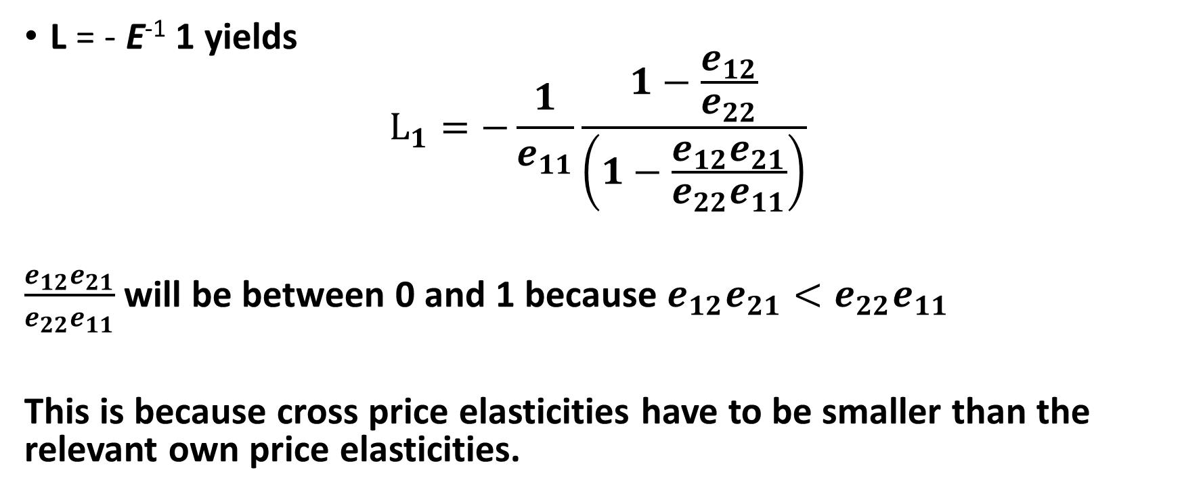
Two Good Formula
L = - E⁻¹ 1 yields
$$L_{1}=−\frac{1}{e_{11}}\frac{1−\frac{e_{12}}{e_{22}}}{\left(1−\frac{e_{12}e_{21}}{e_{22}e_{11}}\right)}$$
$\frac{e_{12}e_{21}}{e_{22}e_{11}}$ will be between 0 and 1 because $e_{12}e_{21}<e_{22}e_{11}$
This is because cross price elasticities have to be smaller than the relevant own price elasticities.

Slide 74

Two Good Formula
L = - E⁻¹ 1 yields
$$L_{1}=−\frac{1}{e_{11}}\frac{1−\frac{e_{12}}{e_{22}}}{\left(1−\frac{e_{12}e_{21}}{e_{22}e_{11}}\right)}$$
$$=−\frac{1}{e_{11}}\frac{1−\frac{+}{−}}{\left(1−\frac{++}{−−}\right)}=−\frac{1}{e_{11}}\frac{>1}{\left(0−1\right)}$$
Markup rise if goods are substitutes

Slide 75
Two Good Formula for Substitutes
L = - E⁻¹ 1 yields
$$L_{1}=−\frac{1}{e_{11}}\frac{1−\frac{e_{12}}{e_{22}}}{\left(1−\frac{e_{12}e_{21}}{e_{22}e_{11}}\right)}$$
$$=−\frac{1}{e_{11}}\frac{1−\frac{+}{−}}{\left(1−\frac{++}{−−}\right)}=−\frac{1}{e_{11}}\frac{>1}{\left(0−1\right)}$$
Is positive for substitutes
Markup rises

Slide 76

Two Good Formula for Substitutes
L = - E⁻¹ 1 yields
$$L_{1}=−\frac{1}{e_{11}}\frac{1−\frac{e_{12}}{e_{22}}}{\left(1−\frac{e_{12}e_{21}}{e_{22}e_{11}}\right)}$$
Is positive for substitutes
Markup rises because firm “is competing with itself”, lowering the incentive to drop prices. Effect is larger when cross price elasticities are larger and own price elasticity of the “good 2” is smaller.
Intuition: when own price elasticity of good 2 is relatively small (close to 1), I have lots of pricing power on that good. If the cross price elasticity is relatively high, then lowering the price of good 1 cannibalizes lots of sales that would have been high profit.

Slide 77

Two Good Formula for Complements
Is negative for complements, so markup goes down
L = - E⁻¹ 1 yields
$$L_{1}=−\frac{1}{e_{11}}\frac{1−\frac{e_{12}}{−}}{\left(0−1\right)}$$
Markup goes down because products “help each other”. Effect is larger when cross price elasticities (can give more help) are larger and own price elasticity of the “good 2” is smaller (meaning dropping the other price is a relatively efficient way to help).
Intuition: when own price elasticity of good 2 is relatively small (close to 1), I have lots of pricing power on that good. If I can drop price of good 1 to help that good, I get lots of benefit from doing so due the high margins on good 2.

Slide 78
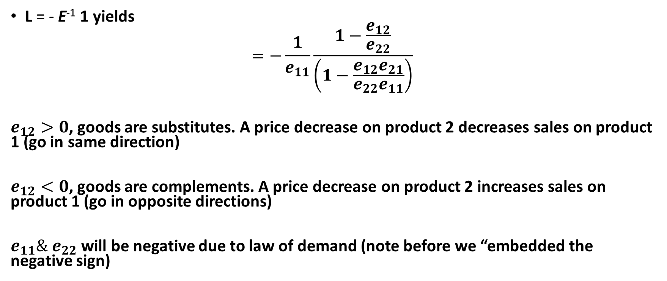
Two Good Formula Review
L = - E⁻¹ 1 yields
$$=−\frac{1}{e_{11}}\frac{1−\frac{e_{12}}{e_{22}}}{\left(1−\frac{e_{12}e_{21}}{e_{22}e_{11}}\right)}$$
$e_{12}>0$, goods are substitutes. A price decrease on product 2 decreases sales on product 1 (go in same direction)
$e_{12}<0$, goods are complements. A price decrease on product 2 increases sales on product 1 (go in opposite directions)
$e_{11}\& e_{22}$ will be negative due to law of demand (note before we “embedded the negative sign)

